Slide 1
RACE-IT: A Reconfigurable Analog Computing Engine for In-Memory Transformer Acceleration
Lei Zhao, Aishwarya Natarajan, Luca Buonanno, Archit Gajjar, Ron Roth, Sergey Serebryakov, John Moon, Omar Eldash, Jim Ignowski, Giacomo Pedretti
Artificial Intelligence Research Lab (AIRL), Hewlett Packard Labs, USA

Slide 2
Analog In-Memory Computing
Digital Accelerator
Analog Dot-Product Engine (DPE)
PE
PE
…
PE
PE
PE
…
PE
Weight Buffer
Output Buffer
…
…
…
Input Buffer
PE
PE
…
PE
Input Buffer
O
I
Output Buffer
W
I
O
Memory
Memory
Reduced data movement → strong energy efficiency
Natural VMM via Ohm’s & Kirchhoff’s laws
Extremely high parallelism & compute density
Heavy DAC/ADC overhead (area & power)
Limited support for complex/nonlinear operations
Memory–compute separation → high data movement cost
Low energy efficiency

Slide 3
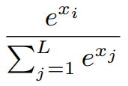


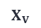



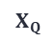


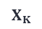



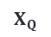

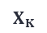

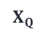



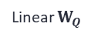



Challenges
Self-Attention
DMMul: DPE
Softmax: VFU
DMMul: VFU
Softmax: VFU
Linear
Linear $V$
DMMul_2
Linear $V$
DMMul_2
DMMul_2
$$X_{V}$$
$$W_{V}$$
$$V$$
$$X_{V}$$
$$W_{V}$$
VFU
Softmax
Linear $K$
DMMul_1
Softmax
Linear $K$
DMMul_1
Softmax
$$X_{K}$$
$$W_{K}$$
$$K$$
VFU
$$X_{K}$$
$$W_{K}$$
VFU
VFU
Scale
DMMul_1
$$X_{Q}$$
$$W_{Q}$$
$$X_{Q}$$
$$W_{Q}$$
$$Q$$
$$K$$
$$V$$
Linear $Q$
Linear $Q$
Linear $W_{Q}$
Linear $W_{K}$
Linear $W_{V}$
$$X_{Q}$$
$$X_{K}$$
$$X_{V}$$
= DPE
= DPE read
= DPE write
Non-VMM operations are pervasive in Attention
Data Dependent Matrix Multiplication (DMMul): both operands (e.g., Q, K) are dynamically generated for each input
Opt 1: Frequent ReRAM reprogramming is required.
Opt 2: Digital multipliers ( Vector Functional Units) are needed.
Softmax involves exponentiation and division operations.
New activations (e.g., GELU) may be introduced in future models.

Slide 4
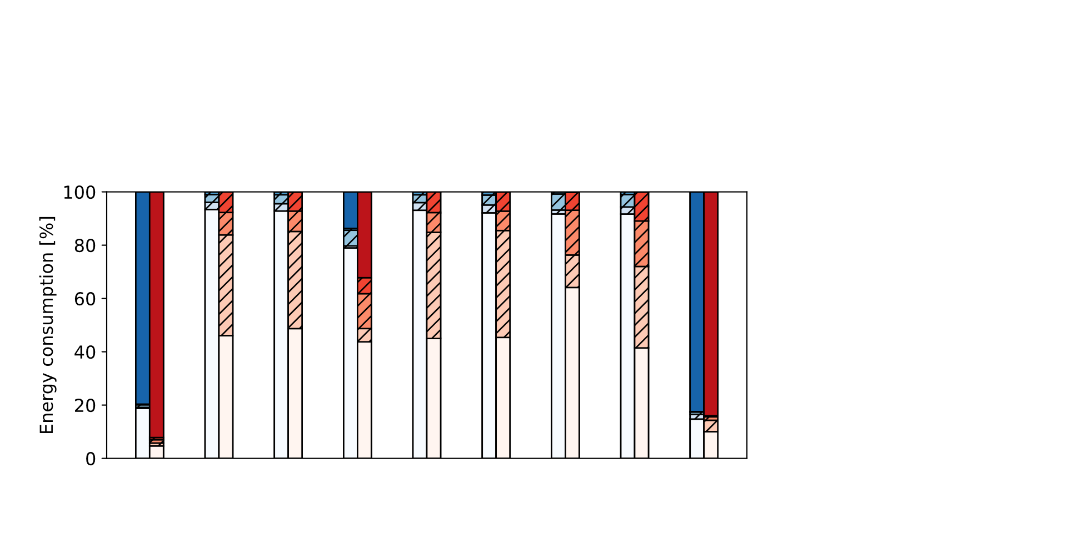
Challenges
MNIST
CIFAR10
ImageNet
GLUE
ISAAC
RAELLA
ADC
Crossbar
Data movement
DAC
VFU
LeNet
ResNet18
SENet
EfficientNet
ResNet34
VGG11
ShuffleNet
DenseNet
BERT-tiny
CNN
Overhead mainly fromADCs converting analog DPE outputs to digital.
Attention
ADC overhead remains.
Energy is dominated by non-VMM ops (DMMul, Softmax, activation)

Slide 5
Analog Content Addressable Memory (ACAM)
Computional principle
ACAM cell Structure
Computing with ACAM Array
An ACAM cell has a 6T2M structure and can store an analog range (upper and lower thresholds).
The cell outputs a MATCH only if the input falls within its stored range.
In an ACAM array, multiple rows compare against the input vector in parallel.
A row outputs a MATCH only if all cells in that row match the input.

Slide 6
RACE: Reconfigurable Analog Computing Engine
Mode 1: Univariate 8-bit Comparison
8-bit input and thresholds
Decompose to 4-bit MSB and 4-bit LSB
MATCH: if input is in the range
Mode 2: Bivariate 4-bit Comparison
4-bit inputs and thresholds
2 inputs with their own ranges
MATCH: if both inputs are in their respective range
No hardware change for mode switch
Only depends on stored threshold and input value
RACE cell structure

Slide 7
Activation (Univariate 8-bit Comparison Mode)
:
Dataset
Dataset
RACE
RACE
Each output bit is computed separately
Output Gray code reduces ~2X RACE array size

Slide 8
DMMul (Bivariate 4-bit Comparison Mode)
z = x * y
3-bit input, 6-bit output
Each output bit is computed separately
Group 1s in a similar way as solving a Karnauph map
Each grouped rectangle is a range that will be stored in an ACAM cell

Slide 9
DMMul (Bivariate 4-bit Comparison Mode)
Apply gray encoding changes the pattern, but the number of ranges does not necessarily change.
Apply more iterations of Gray encoding on top on the Gray-encoded output.
Find the best encoding depth with the least number of ranges.

Slide 10
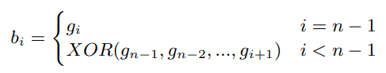
Decoding Gray Code
:
Decoding formula
Decoding Schematic
Gray code outputs have to be decoded to binary code before subsequent computations
Decoding only requires simple XOR gates
To support multi-depth decoding, the outputs of XOR gates are latched and fed back for additional decoding rounds

Slide 11
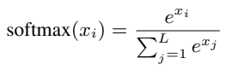
Softmax
Exponentiation: implemented in RACE using Univariate 8-bit Comparison mode
Inversion: implemented in RACE using Univariate 8-bit Comparison mode
Multiplication: implemented in RACE using Bivariate 4-bit Comparison mode
Addition: performed by digital adders (well optimized, minimal overhead)

Slide 12
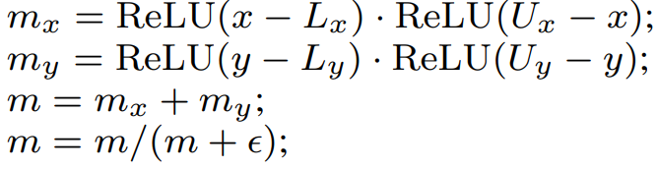
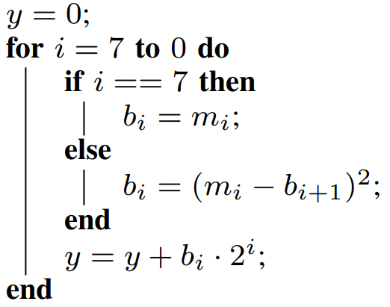
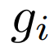
Noise Aware Fine-tuning (NAF)
Differential RACE Operation
Differential Gray Decoding

Slide 13
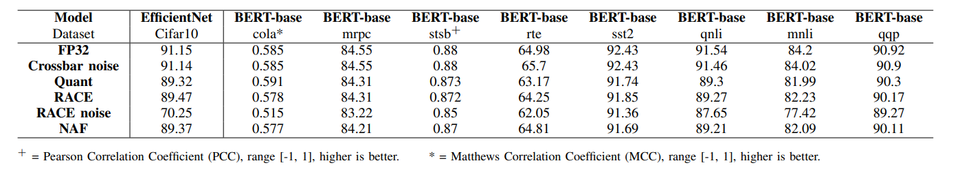
Accuracy
Test both CNN workload (EfficientNet on Cifar10) and Transformer workload (BERT on GLEU dataset).
Step 1: Apply noise on ReRAM cells in crossbar, and mitigate the error with a few more iterations of training.
Step 2: Quantize the output of act/Softmax/DMMul.
Step 3: Replace act/Softmax/DMMul with RACE-based computation.
Step 4: Apply noise on ReRAM cells in ACAM.
Step5: Apply NAF to mitigate errors in ACAM.

Slide 14
Performance & Energy
Eyeriss: a PE array based digital accelerator
PUMA: a crossbar-based accelerator with VFU for non-VMM operations
ReTransformer: a crossbar-based accelerator that needs programming crossbars to compute DMMul
453X performance speedup and 354X energy reduction over a H100 GPU.
15X speedup and 122x energy reduction over other IMC accelreators

Slide 15
Thank you

